Slide 1
SRMLB – KBGGG Working Groups

Slide 2
Workgroups
Workgroups : 3 levels
Formation – Education (workgroup A + B) :
Quality Control
Policy (workgroup E = board en ex-board members)
National:
International
ethics – deontology

Slide 3
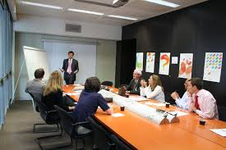
Formation – Education (workgroup A + B) :
Journal clubs – Formation continue (workgroup A)
Congress (workgroup B)
Social events (workgroup B)

Slide 4
Quality Control
Standardization of rapports (workgroup C):
PM:
Autopsy
CSI
Clinical FM
Accreditation (workgroup D)

Slide 5
Policy (workgroup E = board en ex-board members)
National:
Statuut van de wetsarts – statut du médecin légiste (workgroup E)
Erkenning specialisme – reconnaissance du spécialism
Justitie – justice / Volksgezondheid – santé publique (anatomopathologie)
FOD volksgezondheid, autopsies plotse dood (< 45 y)
Betaling – rémuneration (workgroup F):
Payment of the expert
Support? (vb. dienst in nood procedure)
Deontology (workgroup G) :
Intern (conter expertise)
Extern (media,…)
Advisory board Magistrates (workgroup E)
DVI contacts

Slide 6
Policy (workgroup E = board en ex-board members)
International (workgroup E):
National directives on QC – ethics – deontology
Interpol collaboration

Slide 7
Active participation
Each member if possible
Working time ?
Results expected ?

